Slide 1
U.S. Environmental Protection Agency
Educator Resources
Lee Pera and Ethan McMahon
Office of Environmental Information
July 21, 2010

Slide 2
Agenda
About EPA
How EPA Can Help Educators
Other EPA Resources
Report on the Environment (ROE)
Educators’ Guide to the ROE Highlights Document

Slide 3
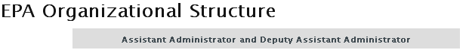

About EPA
Founded in 1970 Mission: Protect human health and the environment

Slide 4
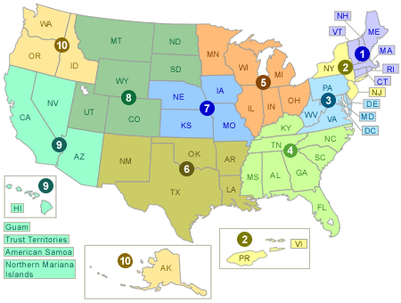
10 EPA Regional Offices

Slide 5
What EPA Does
Develop and enforce regulations
Provide grants
Study environmental issues
Sponsor partnerships
Teach people about the environment
Publish information

Slide 6
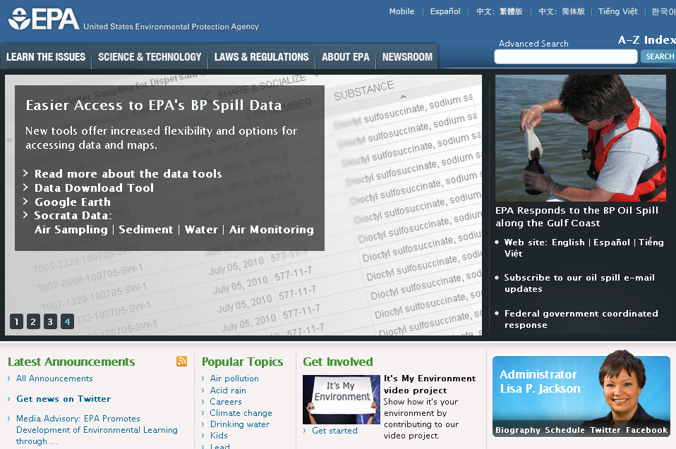
Key Issues EPA Addresses
Air
Climate
Water
Wastes and pollution
Green living
Human health
Ecosystems

Slide 7
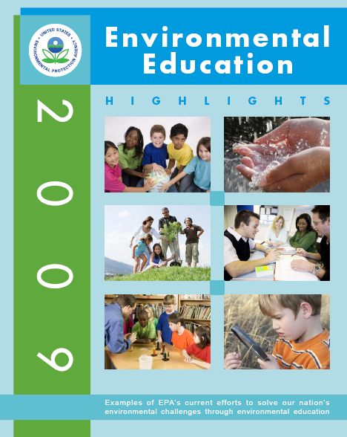
EPA Resources for Educators
Grants
Training
Teaching tools
School health programs
EE Clearinghouse
EE Regional Coordinators
http://www.epa.gov/teachers
http://www.epa.gov/education/pdf/2009_EEHighlights.pdf

Slide 8
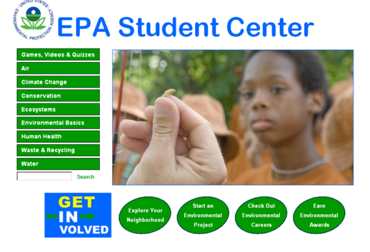
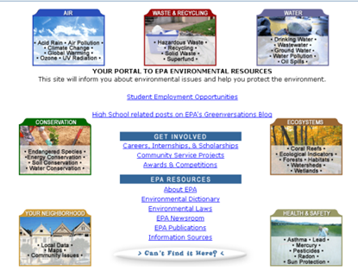
EPA Student Resources
Elementary: www.epa.gov/kids/club
Middle school: www.epa.gov/students
High school: www.epa.gov/highschool

Slide 9
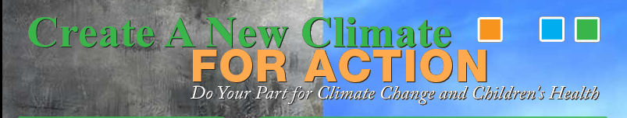
Sample Campaign: Climate Change for Action (Region 4)
Goal: Educate students about climate change and reducing their carbon footprint
On Earth Day, EPA volunteers visited 24 middle and high schools; participated in conferences
Reached 11,000 people
http://www.epa.gov/climateforaction

Slide 10


Sample Teaching Tools: Air and Waste
Quest for Less Curriculum (K-8)
  http://www.epa.gov/wastes/education/quest/quest.htm
Your Environment, Your Choice (high school)
http://www.epa.gov/epawaste/education/teens/index.htm
Air Quality Index Toolkit (K-8)
  http://www.airnow.gov/index.cfm?action=resources.aqi_toolkit

Slide 11

Sample Educator Training:
Watershed Academy
Provides broad introduction to watershed management field
50 self-paced training modules
Monthly webcast seminars
Training courses
www.epa.gov/owow/watershed/wacademy

Slide 12
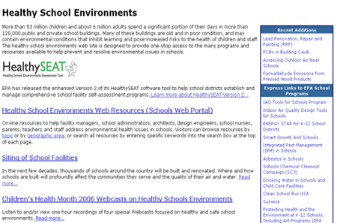
Healthy School Environments
Programs and resources for school administrators
Address environmental issues in schools
  Indoor air
  Energy conservation
  Recycling/waste
  Reducing chemicals
  Clean school buses
  Sun protection
http://www.epa.gov/schools/

Slide 13
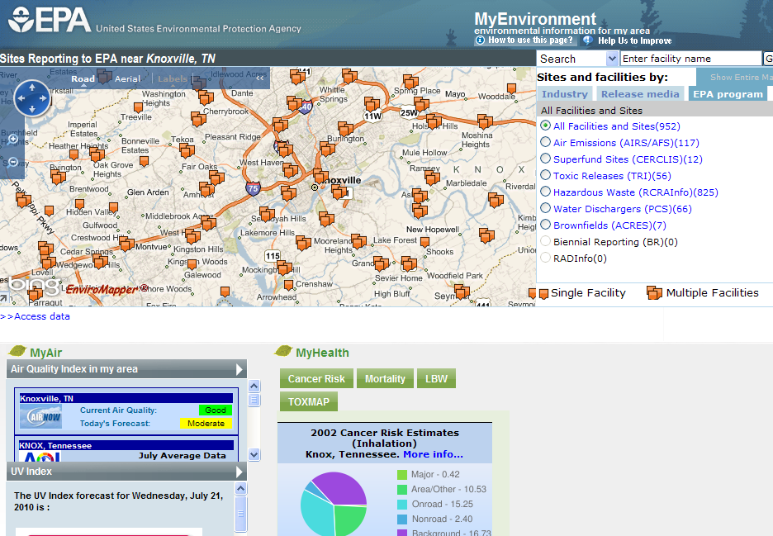
Entry points to EPA Data
MyEnvironment
Envirofacts
Datafinder
Science Inventory

Slide 14
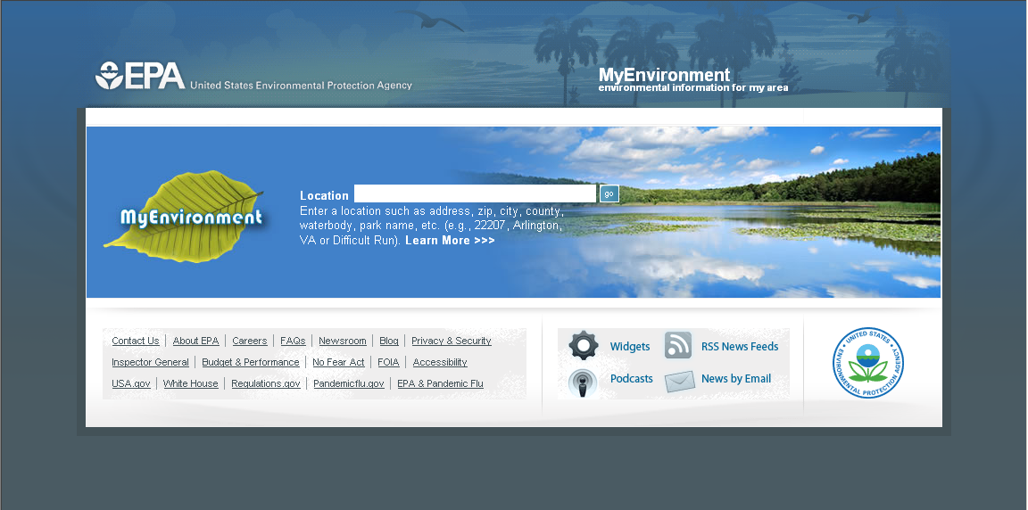
MyEnvironment
Provides information on environmental conditions in a specific locale: address, zip code, city, county, etc.
www.epa.gov/myenvironment

Slide 15
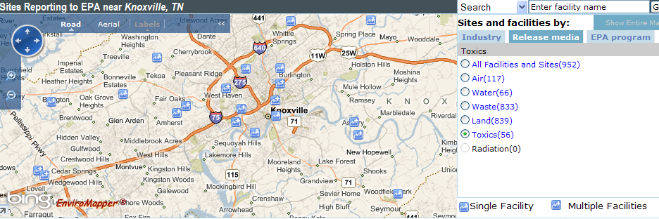
MyEnvironment
Refine searching by:
  Industry (such as manufacturing)
  Media (land, air, or water)
  Pollutant
  Geographic location

Slide 16
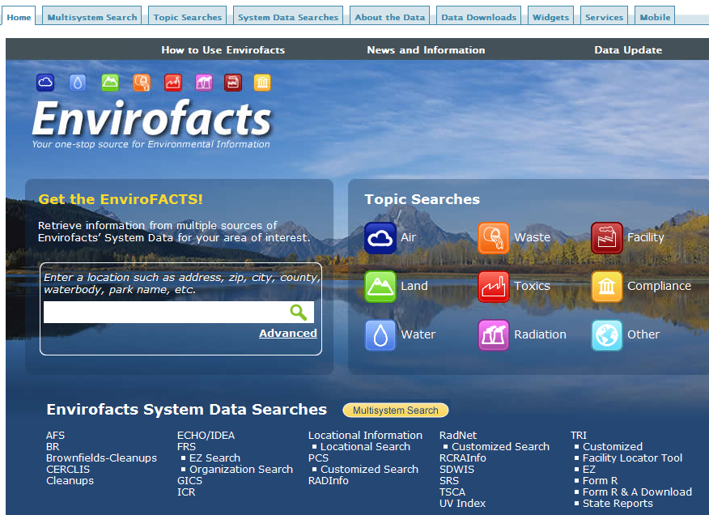
Envirofacts
  Searches across multiple EPA databases for information on:
  Air
  Water
  Land
  Waste
  Toxics
  Radiation
  Facility
  Compliance
www.epa.gov/enviro

Slide 17
Data Finder
A single place to find EPA’s data sources
  Data sources are where you can download datasets
Encourages people to suggest additional data sources
http://www.epa.gov/data/

Slide 18
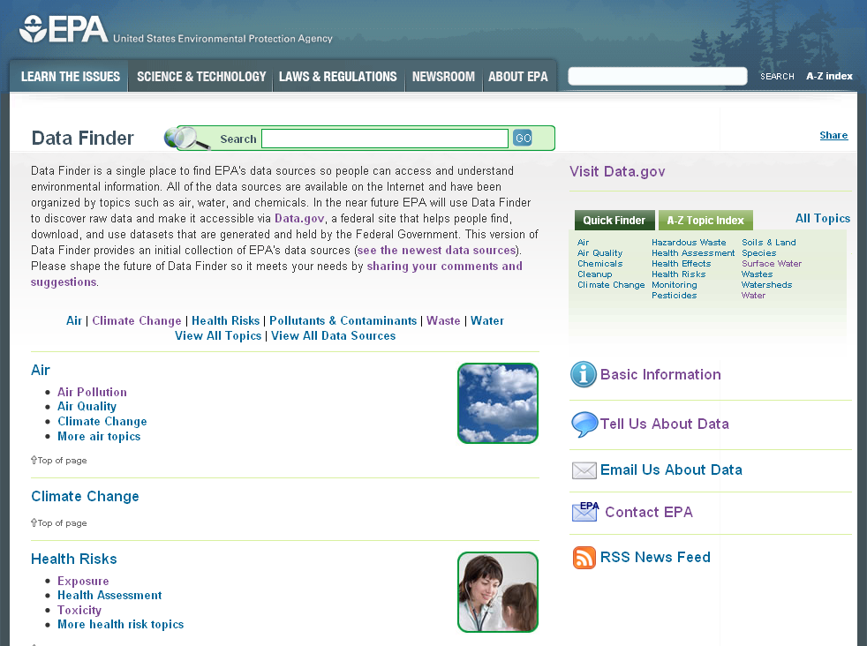
Data Finder: Home Page
Search bar
Environmental
topics
Forum for participation

Slide 19
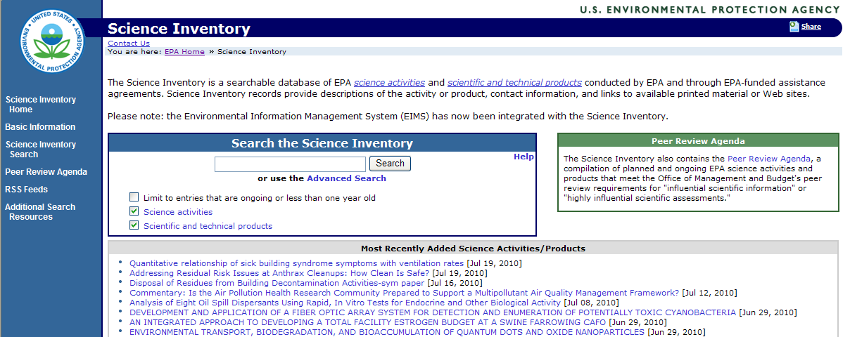
Science Inventory
Searchable database of EPA scientific research activities and technical products
http://cfpub.epa.gov/si/

Slide 20

Report on the Environment
Developed by EPA’s Office of Research and Development and the Office of Environmental Information
First published in 2003
Latest report 2008
Quarterly website updates
Displays environmental indicators
Illustrates conditions and trends in:
  Environment (air, water, land)
  Human Health
  Ecosystems
www.epa.gov/roe

Slide 21
Environmental Indicators
Actual measurements of environmental condition
Tracked over time
Provide insight into the state of the environment or human health
Can be developed and used locally, regionally, and nationally

Slide 22
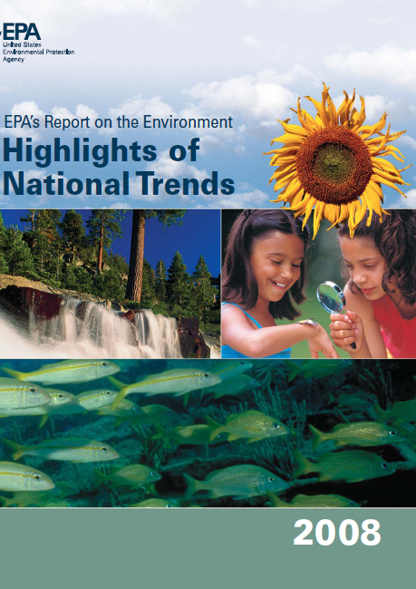
EPA’s Report on the Environment:
Highlights of National Trends
“HD” for short
Broken down into 25 topics
  One page per topic
www.epa.gov/roehd/pdf/roe_hd_layout_508.pdf

Slide 23
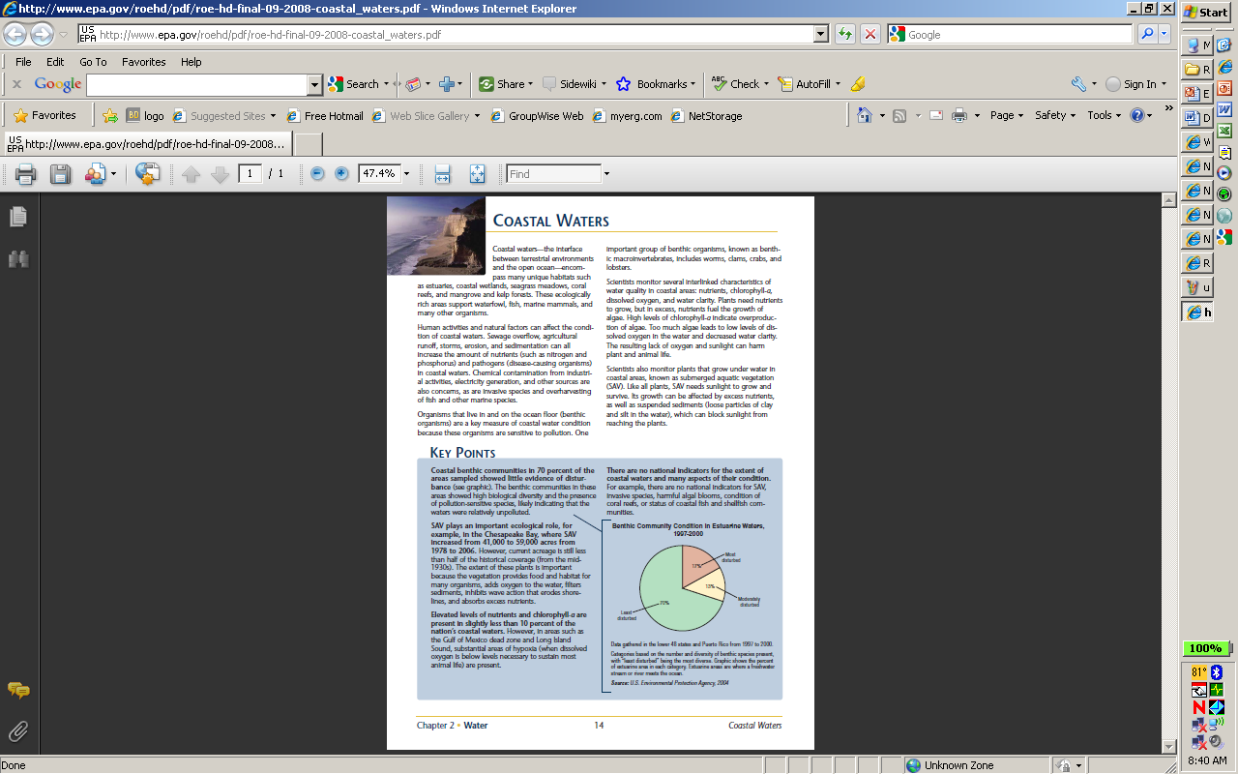
HD Sample Topic Page: Coastal Waters
Context
Key points
Graphic

Slide 24
Feedback on HD from Educators
A lot of information to deal with all at once and hard to navigate content
Information useful to introduce subjects, but hard to relate to local environment
Suggested a guide for educators

Slide 25
Educational Use of Indicators
Teach about current trends in the environment and human health
Demonstrate important scientific research principles
Teach interpretation of environmental datasets
Engage students in critical thinking and in collecting environmental data locally and through “citizen science” networks
From: 2099 Environmental Education Highlights, EPA,
www.epa.gov/education/pdf/2009_EEHighlights.pdf

Slide 26
We Want Your Feedback…
  …On the Educators’ Guide
  Relevance to your classes
  Ease of use
  Content
  Format
  Length

Slide 27
Proposed Outline for Educator’s Guide
Why Teach About Coastal Waters?
Using Environmental Indicators to Teach About Coastal Waters
Discussion Questions
Research Activities
Community Activities
Featured Resources
EPA Resources

Slide 28

Development Schedule
Summer 2010:
  Get feedback from educators to help draft Educators’ Guide
Fall 2010:
  Revise guide and release

Slide 29
Contacts:
Pera.Lee@epa.gov
202-566-2332
McMahon.Ethan@epa.gov
202-566-0359
Regional Environmental Education Coordinators:
http://www.epa.gov/enviroed/contacts1.html
Pg #

